Slide 1
Procedural Map Generation Techniques
Presented by Herbert Wolverson Roguelike Celebration 2020

Slide 2
Who is Herbert Wolverson?
Author of the “Rust Roguelike Tutorial”
Author of upcoming book - Learn Rust: Make 2D Games
Author of Nox Futura and far too many words on r/roguelikedev

Slide 3
Source Code and Slides available at:
https://github.com/thebracket/roguelike-celebration-2020

Slide 4
Introduction
What is Procedural Generation?
How does it fit in with hand-made content?
History of Procedural Generation (more slides)

Slide 5
Rogue

Slide 6
Elite

Slide 7
Civilization

Slide 8
Dwarf Fortress

Slide 9
Dungeon Crawl: Stone Soup

Slide 10
No Man’s Sky

Slide 11
PART 1 – Basic Generation Techniques

Slide 12
Simple Room-Based Generation
You’ve probably seen this in Roguelike development tutorials.
Simple algorithm:
Start with a solid map.
Randomly select a room area.
If the room is solid, carve it out and store it in the “rooms” list.
Repeat until you have enough rooms.
Iterate your rooms list, and add dog-leg corridors.

Slide 13
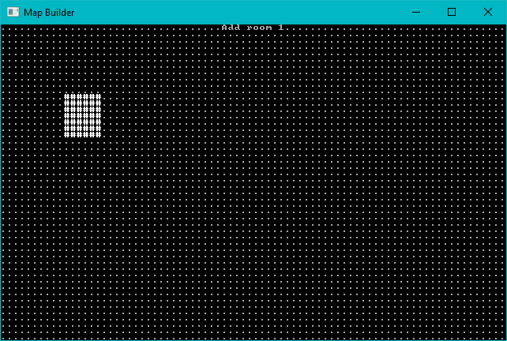
Start with a solid map, add one room at random.

Slide 14
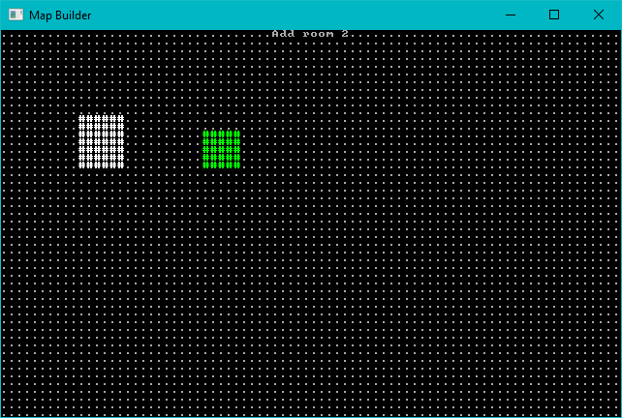
Add a second room

Slide 15
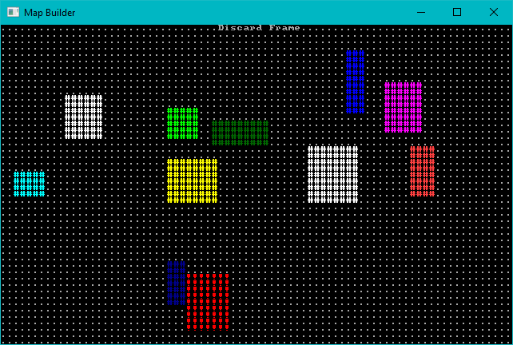
Keep Adding Rooms – Don’t Add Overlapping Ones

Slide 16
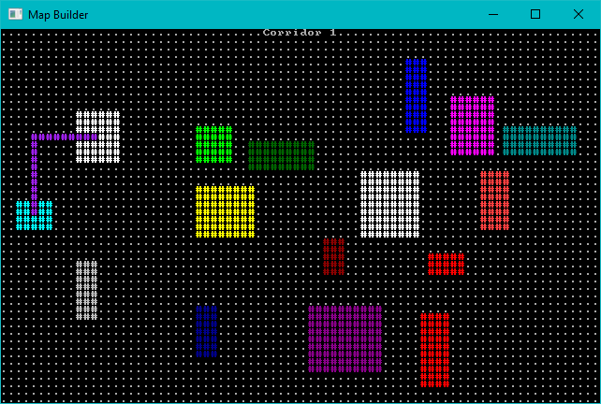
Add Corridors – Dog-leg Style

Slide 17
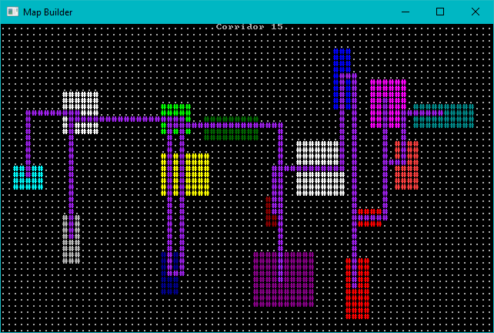
Add More Corridors Until Every Room is Connected

Slide 18
Room Algorithm - Animated

Slide 19
Sub-Divide Room-Based Generation
Nicer room generation. Nethack uses it. (In BSP form)
Divide your map into squares – and divide those squares into squares.
Each sub-square might become a room.
Sort rooms and add corridors.

Slide 20
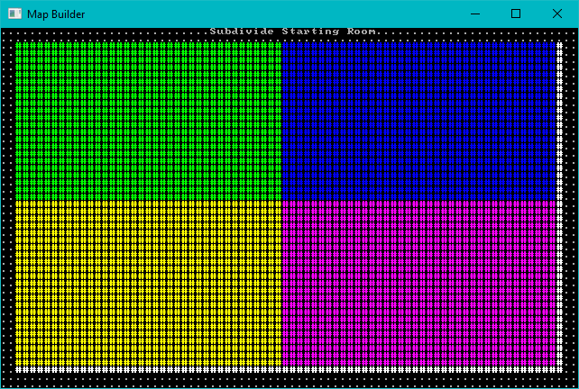
Subdivide the map

Slide 21
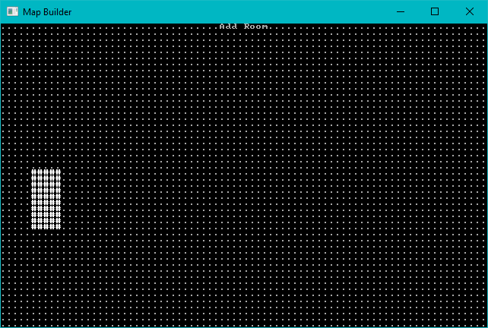
Consider each region. Either divide, or add a room.

Slide 22
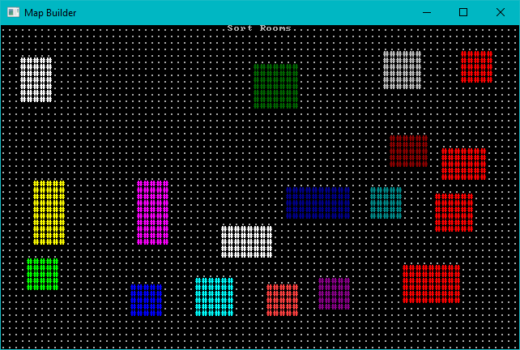
Keep Adding Rooms, Sort by X

Slide 23
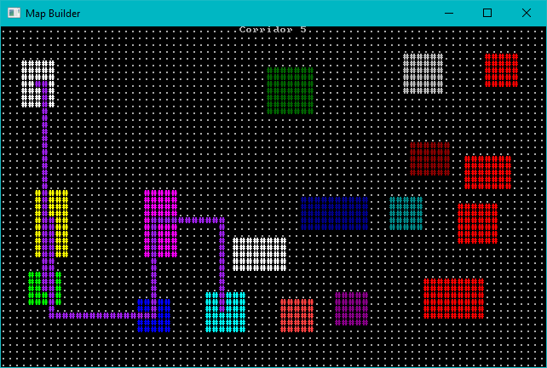
Add Corridors as Before

Slide 24
Animated Sub-Division

Slide 25
Cellular Automata
Evolve order from chaos.
Treat each cell as its own entity, make “live” (become a floor) or “die” (become a wall) decisions by counting neighbors.
Great for organic, natural looking maps.

Slide 26
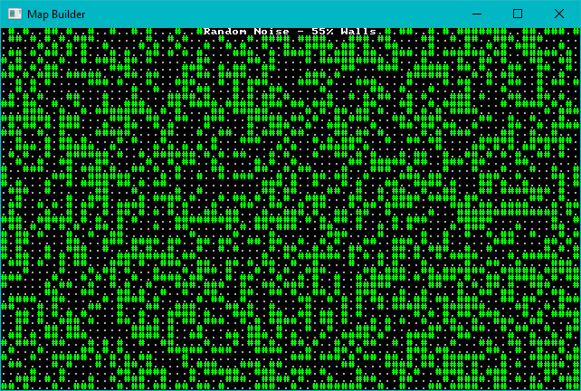
Start with Some Chaos (55% walls)

Slide 27
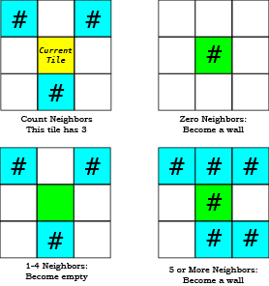
For each tile, count neighbors and decide on its future.

Slide 28
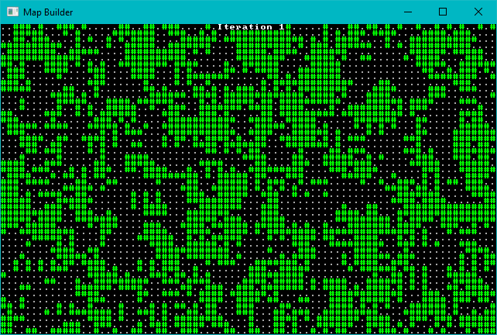
Let each iteration run

Slide 29
Animated Cellular Automata

Slide 30
Drunkard’s Walk
Give an Umber Hulk an unlimited pot of beer, and see what happens.
Starts with a solid level.
Place a digger, and have them stagger randomly clearing tiles.
Find an open tile, and start a new digger there.
Repeat until you have a sufficiently open map.

Slide 31
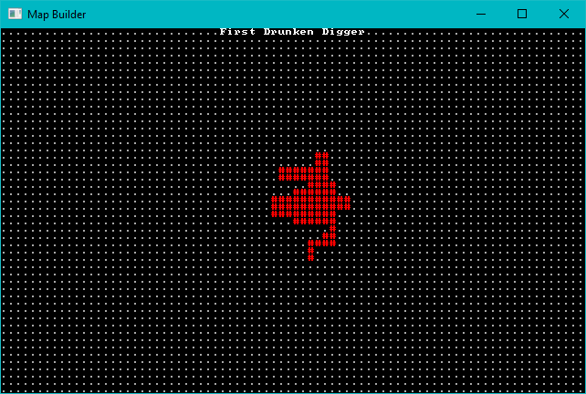
First Random Digger

Slide 32
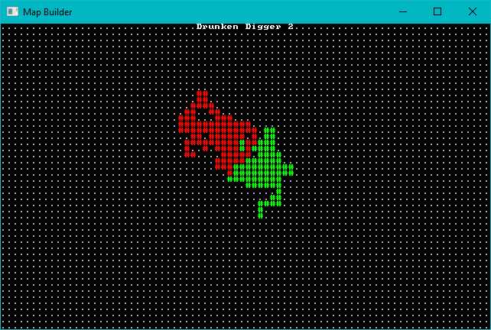
Second Random Digger

Slide 33
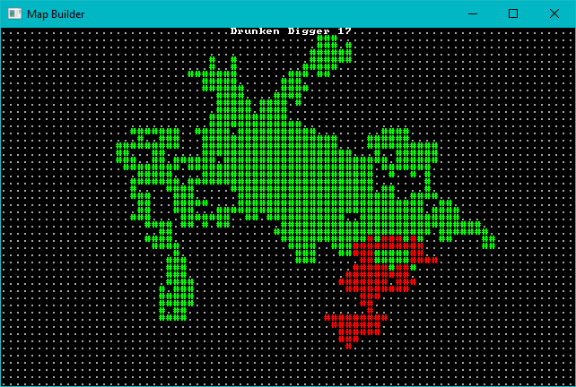
Keep Digging

Slide 34
Animated Drunkard’s Walk

Slide 35
Diffusion Limited Aggregation
Similar to Drunkard’s Walk.
Instead of digging from a random mover’s location, you fire a particle from a random point – and carve out the first wall adjacent to a floor that they hit.
Several variations on this theme.

Slide 36
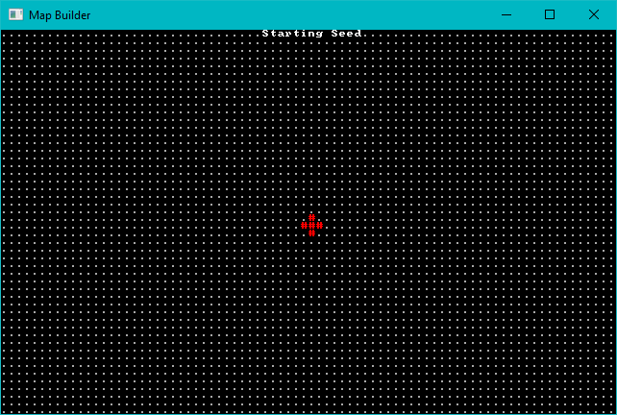
Starting Seed Area

Slide 37
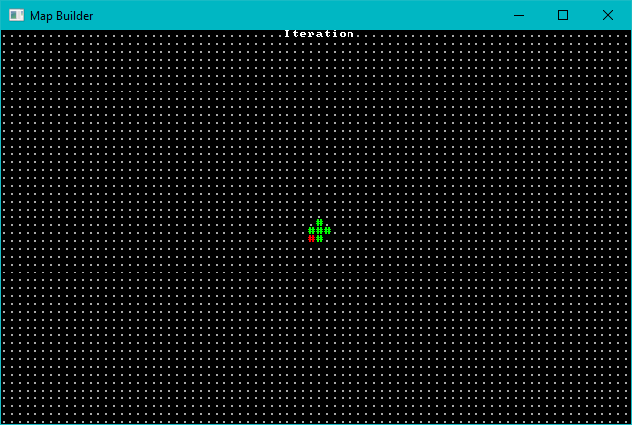
First Particle

Slide 38
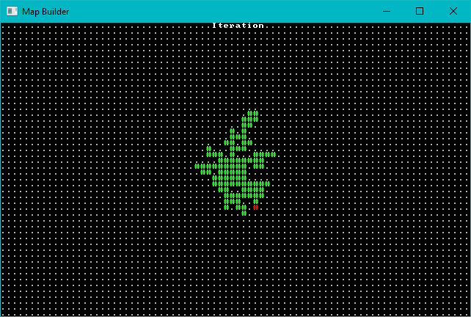
Keep Firing!

Slide 39
Animated Inwards DLA

Slide 40
DLA Variations
Change how the particle travels.
Outwards: start in the middle and keep going outwards until you hit a wall. Very similar to drunkard’s walk.
Attractor: attract particles towards a point, for an open center with random edges.

Slide 41
Animated Central Attractor DLA

Slide 42
Symmetrical DLA

Slide 43
PART 2 – Meta-Builders
One algorithm isn’t always enough.
You can always run a second algorithm using your first as its input.

Slide 44
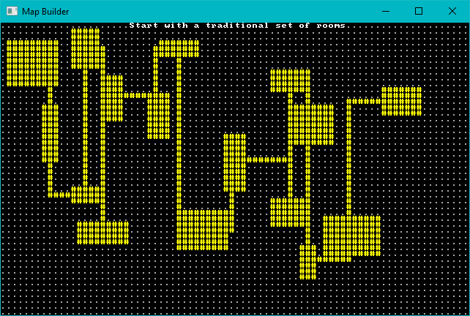
Eroding Maps with DLA

Slide 45

Erosion – Pick a starting point, path randomly until you hit a wall. Dig.

Slide 46
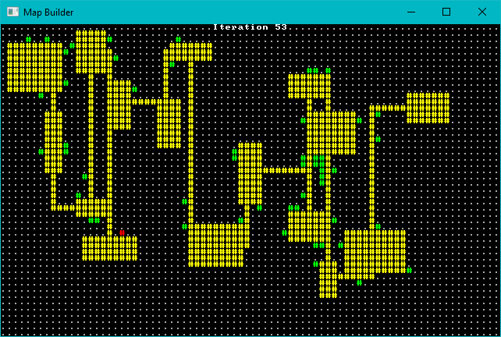
Erosion – Keep Digging!

Slide 47
Animated Erosion

Slide 48
Combining Layers
You don’t have to use just one technique on a map.
Transition maps really benefit from layering multiple techniques.

Slide 49
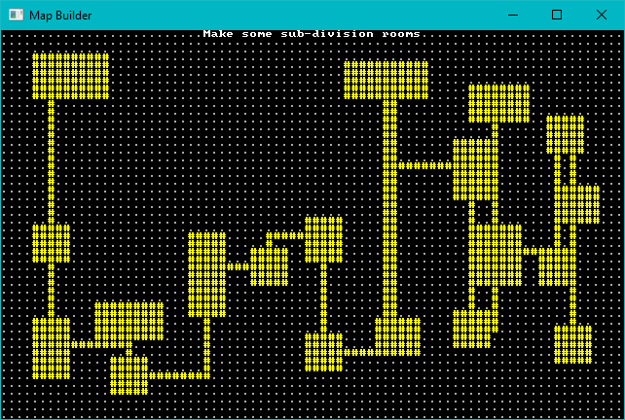
Layers: Start with a Room Map

Slide 50
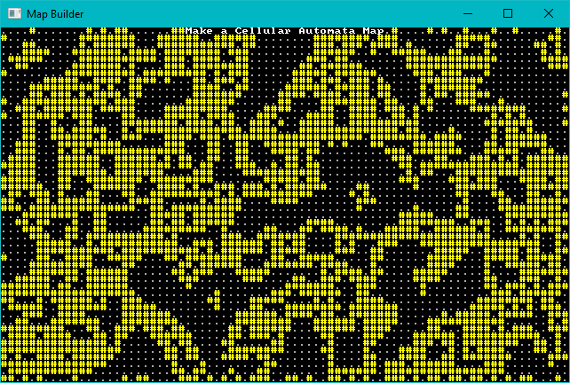
Layers: Make a Cellular Automata Map

Slide 51
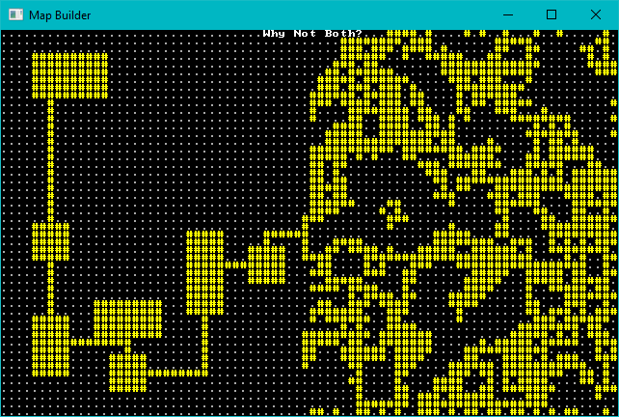
Layers: Add them together

Slide 52
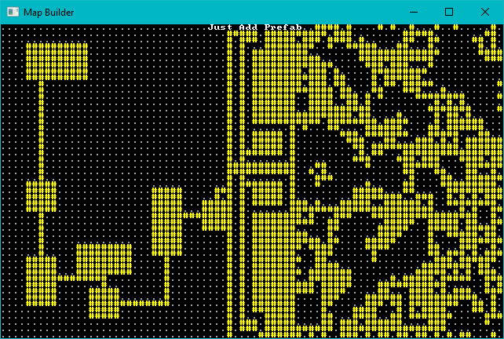
Layers: Extra Fancy with a Prefab

Slide 53
Waveform Collapse

Slide 54
PART 3 – Let’s Make Some Noise

Slide 55
Perlin & Simplex Noise

Slide 56
What does a Noise Map look like?

Slide 57
Noise Tunables

Slide 58
Making an Overworld

Slide 59
Making a Spherical World

Slide 60
Making a 3D Map

Slide 61
PART 4 – Prefabs/Vaults

Slide 62
Wrap-Up

Slide 63
Questions?
Source code: https://github.com/thebracket/roguelike-celebration-2020
I wrote a book:
Learn Rust: Build 2D Games Available soon from PragProg.com

